Slide 1

Topic Name : “ Impact of Social Media on Mental Health ”
Presented by : Komal Khune

Slide 2
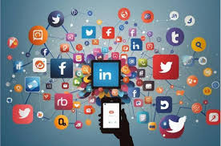

Introduction:-
Social media refers to digital platforms that allow people to create, share, and exchange information with others.
In today’s digital age, social media is not just used for communication but also for education, entertainment, business, and networking.
Social media also provides a space for self-expression, where individuals can share their thoughts, photos, videos, and opinions freely.

Slide 3
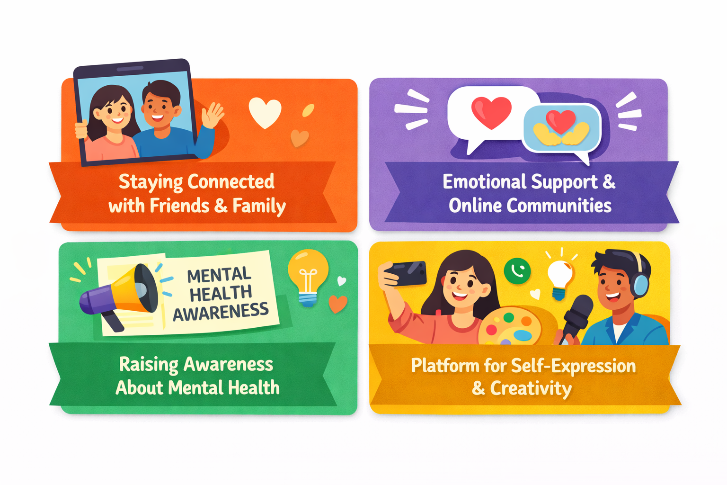
Positive Impacts :-

Slide 4

Negative Impacts :-
Social Media Addiction :-
Constant checking of notifications
Fear of Missing Out (FOMO)
Reduced productivity and focus
Can lead to anxiety and stress

Slide 5
Unrealistic beauty standards
Comparing life with others’ “perfect” posts
Feeling unhappy
Impact on Self-Esteem :-

Slide 6
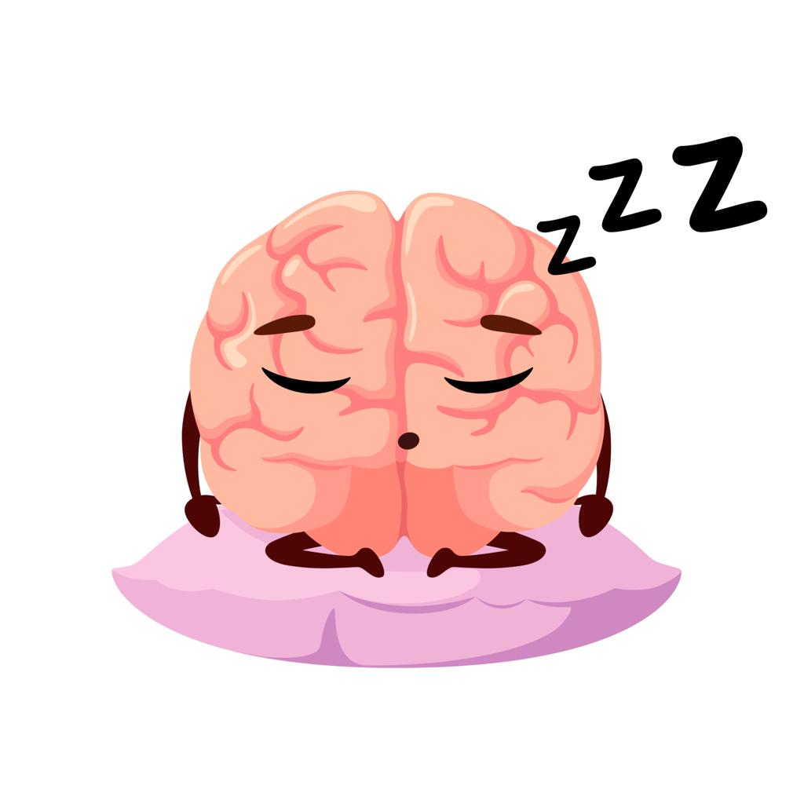
Sleep and Mental Health :-
Excessive use at night reduces sleep quality
Blue light affects brain activity
Poor sleep increases stress and depression

Slide 7
How to Reduce Negative Impact :-
Limit screen time
Take regular breaks from social media
Follow positive and inspiring content
Avoid comparing yourself with others

Slide 8
Conclusion:-
Social media is a powerful tool.
It can be helpful or harmful depending on usage .
Balance and awareness are key to maintaining mental health.

Slide 9


